Slide 1






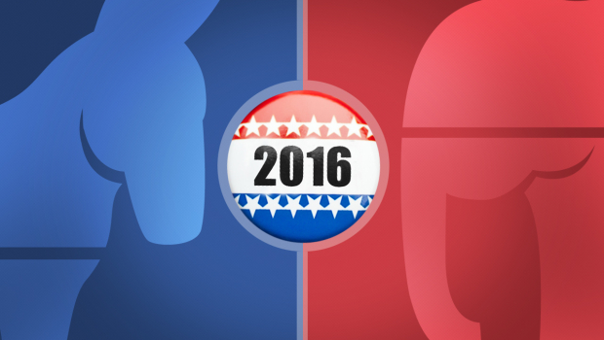
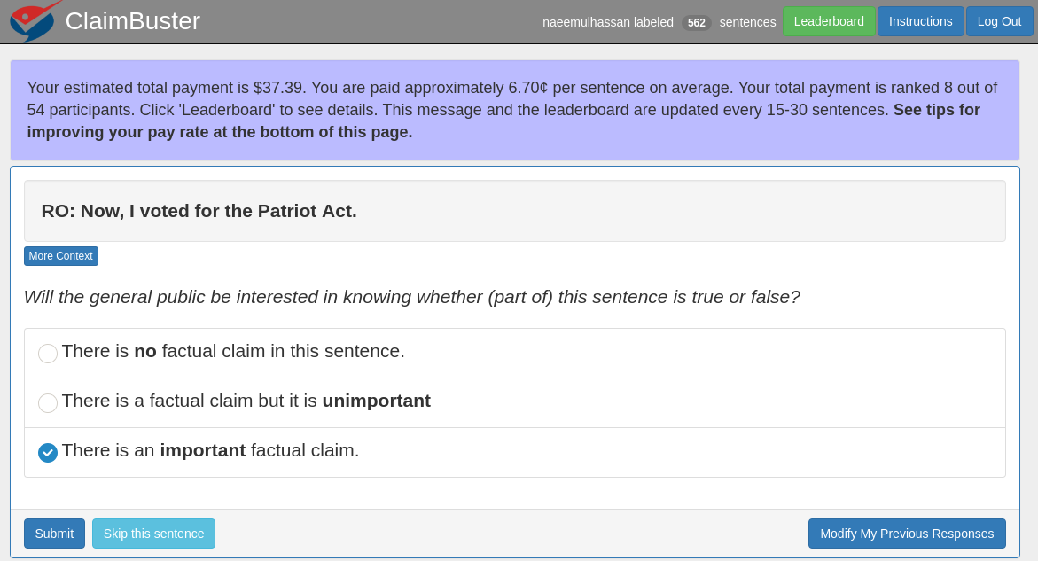
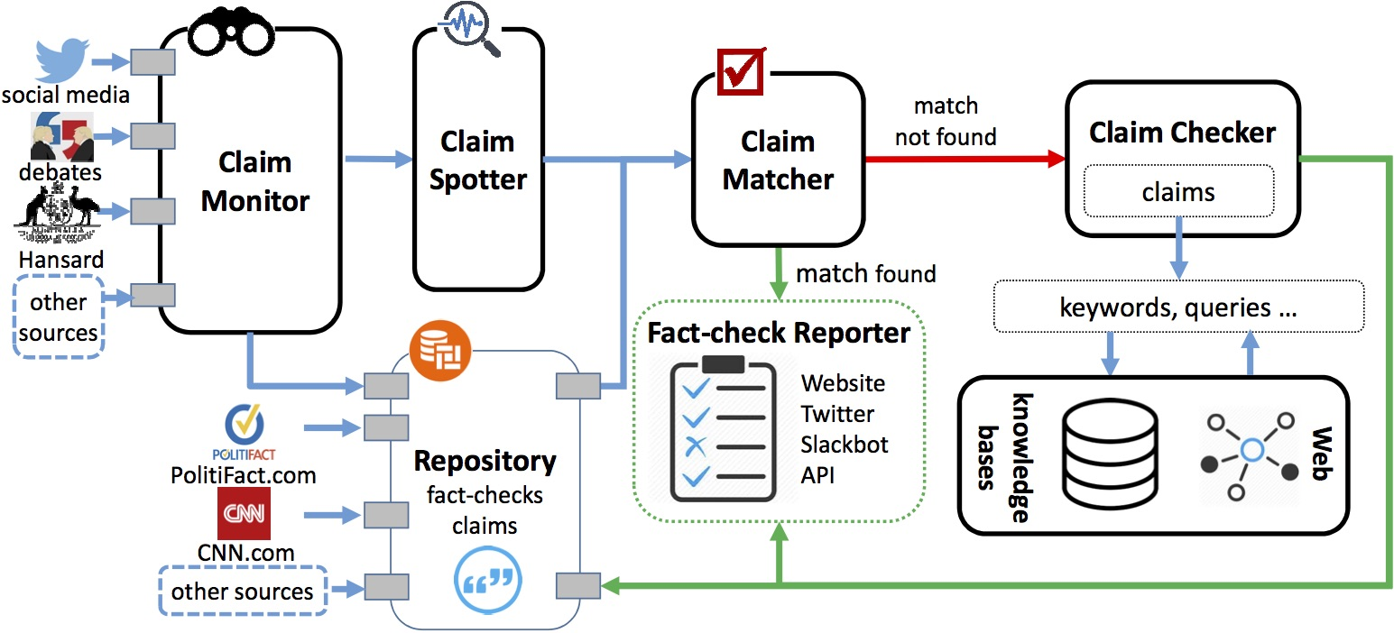
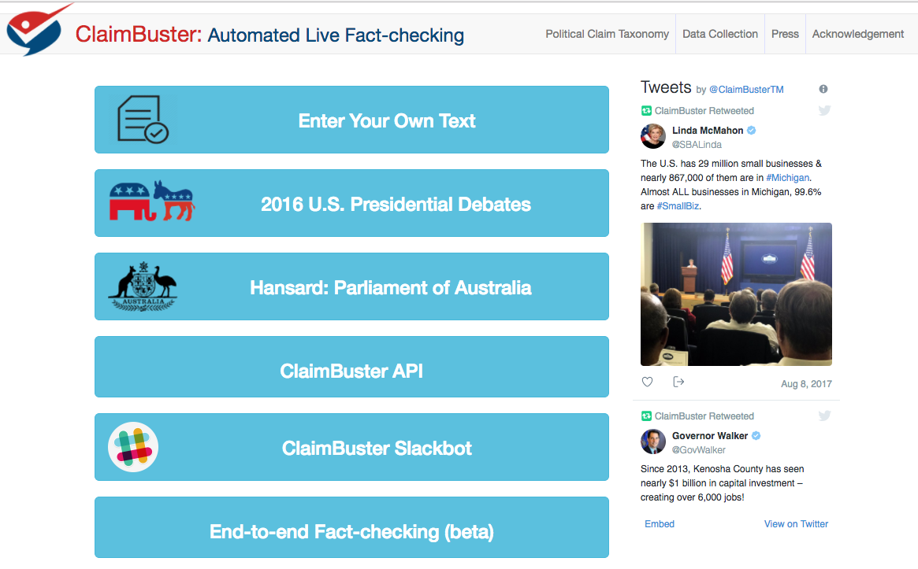
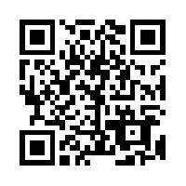
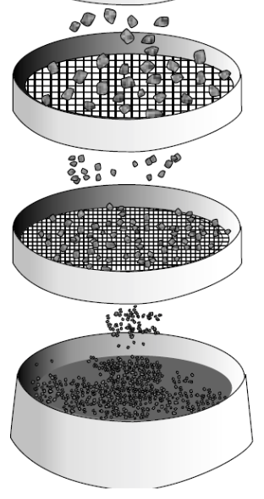
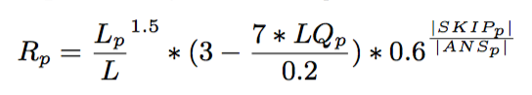
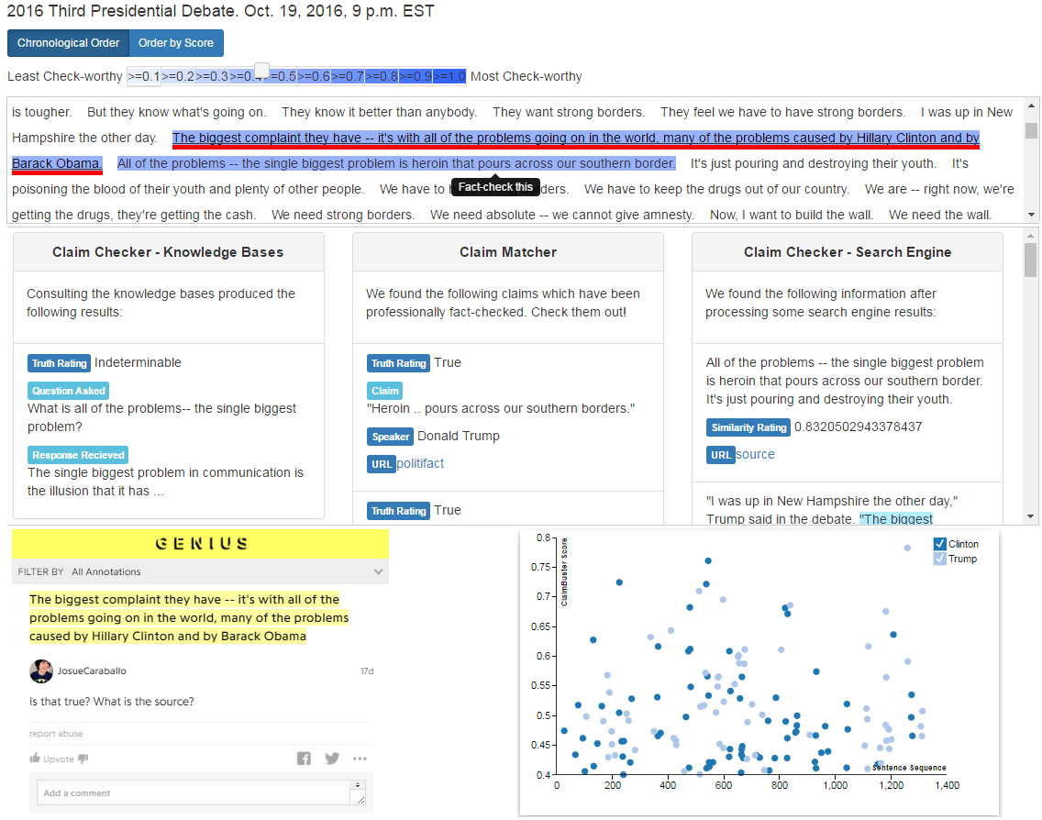
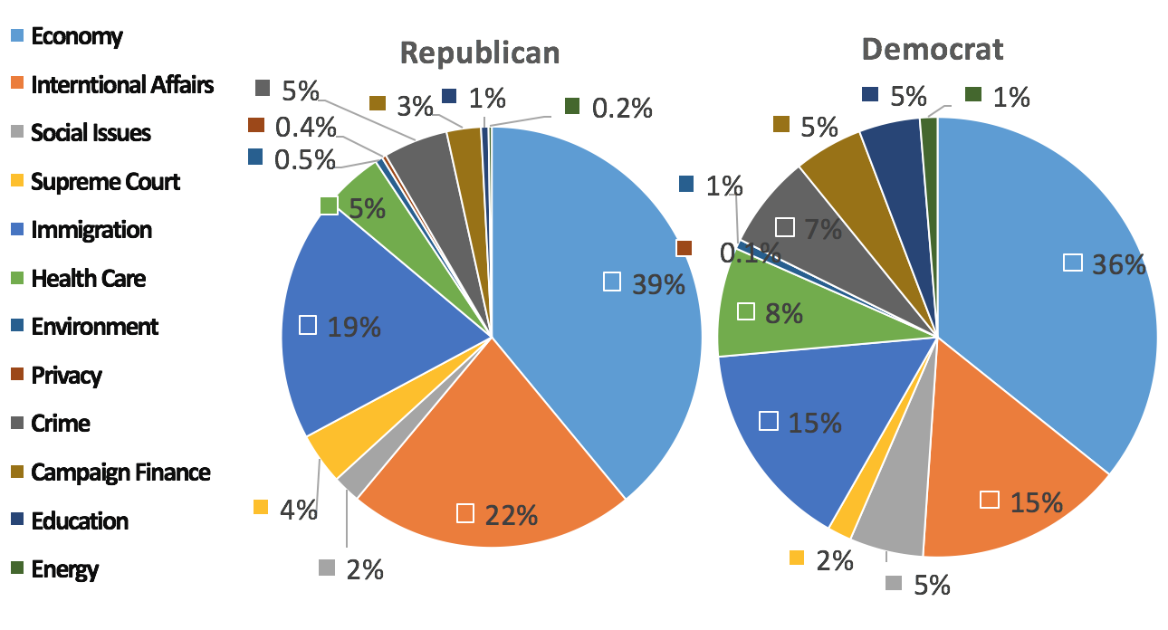
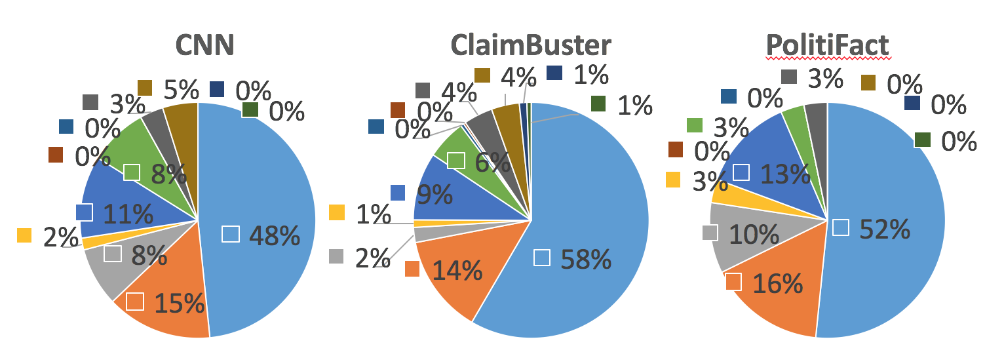

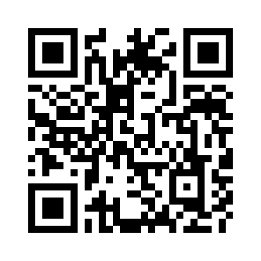

Toward Automated Fact-Checking: Detecting Check-worthy Factual Claims by ClaimBuster
Naeemul Hassan¹ Fatma Arslan² Chengkai Li² Mark Tremayne³
¹Department of Computer and Information Science, University of Mississippi
²Deparment of Computer Science and Engineering, University of Texas at Arlington
³Department of Communication, University of Texas at Arlington
The Quest to Automate Fact-checking
Politicians make false and misleading claims
National security threats
Combating falsehoods
Russian government interfered with the 2016 election. Fake-news websites and bots used.
Pizzagate: conspiracy theory led to shooting
100+ active fact-checking sites in 2017 (PolitiFact.com, FullFact.org, CNN, Washington Post, …)
Google and Bing include fact-checks in search results.
Facebook lets users report false items and flags items disputed by fact-checkers.
Fake-news floods social media (“filter bubbles” and “echo chambers”)
Facebook trending topic algorithms promoted fake-news.
A sample of 140,000 Twitter users in the battleground state of Michigan shared as many junk news items as professional news during the final ten days of the 2016 election. http://politicalbots.org/?p=1064
Lack of automated tools that assist fact-checkers
Fact-checks on major party presidential nominees by PolitiFact
“The Holy Grail”: fully automated fact-checking
Claim Spotting: Check-worthy Factual Claims Detection
Human Annotation
Feature Extraction
Learning Algorithm
Important Factual Claims
Classification and ranking by check-worthiness
Feature extraction and selection
Feature importance
Ground Truth
Feature Vectors
Non-Factual Sentence (NFS) (Opinions, beliefs, declarations): “But I think it’s time to talk about the future.”
Unimportant Factual Sentence (UFS): “Two days ago we ate lunch at a restaurant.”
Check-worthy Factual Sentence (CFS): “He voted against the first Gulf War.”
Sentiment: 0.032
Words: state, legislature, 87, percent, democrat
I was in a state where my legislature was 87 percent Democrat.
Presidential Debate Transcripts (1960-2012)
20788 sentences
2016
Presidential
Debates
Part-of-Speech: Noun
Entity Type: Quantity
Concept: United States
Data Labeling and Ground-Truth Collection
End-to-End Fact-Checking
Coding website
bit.ly/claimbusters
Quality assurance
20788 sentences
20 months, 374 coders, ~$4,000 paid
30 training sentences
1032 screening sentences (731 NFS, 63 UFS, 238 CFS) to detect spammers & low-quality coders
Coder quality
20788 sentences
374 coders
76552 labels
86 top-quality coders
52333 labels
Majority voting
20617 admitted sentences
Classification and Ranking Accuracy
Case Study: 2016 U.S. Presidential Election Debates
System idir.uta.edu/claimbuster
Funded by
Comparison of topic distributions of CNN, PolitiFact fact-checked
sentences and sentences scored high (>=.5) by ClaimBuster

